Slide 1
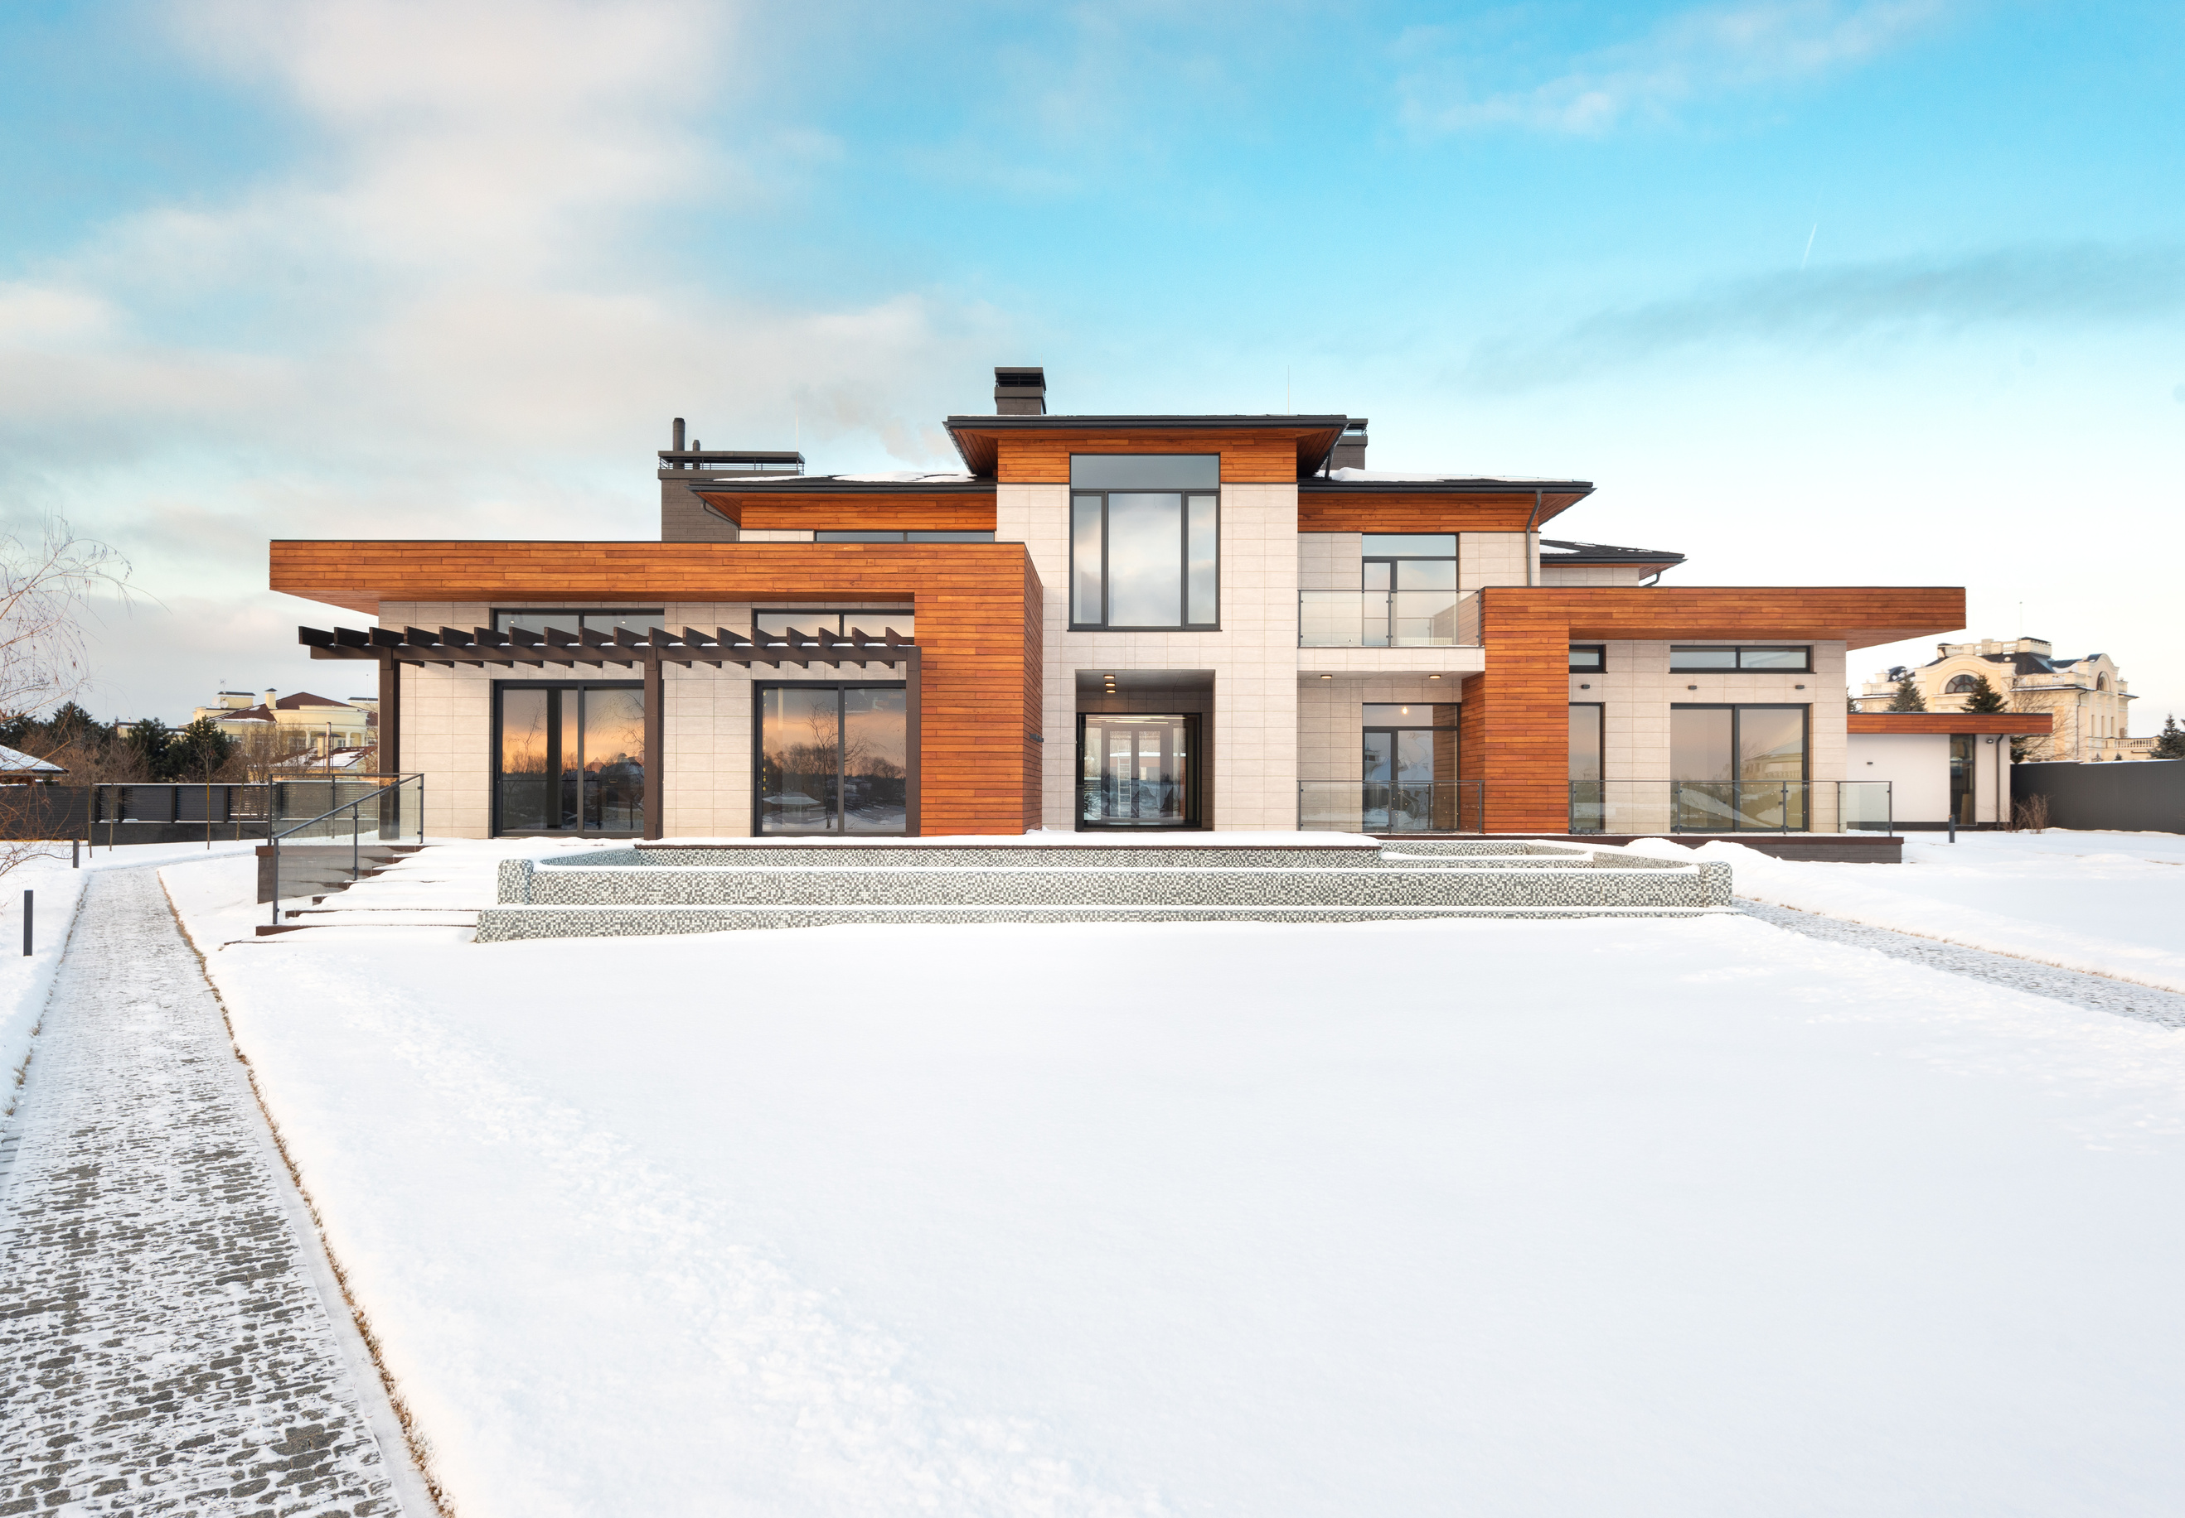
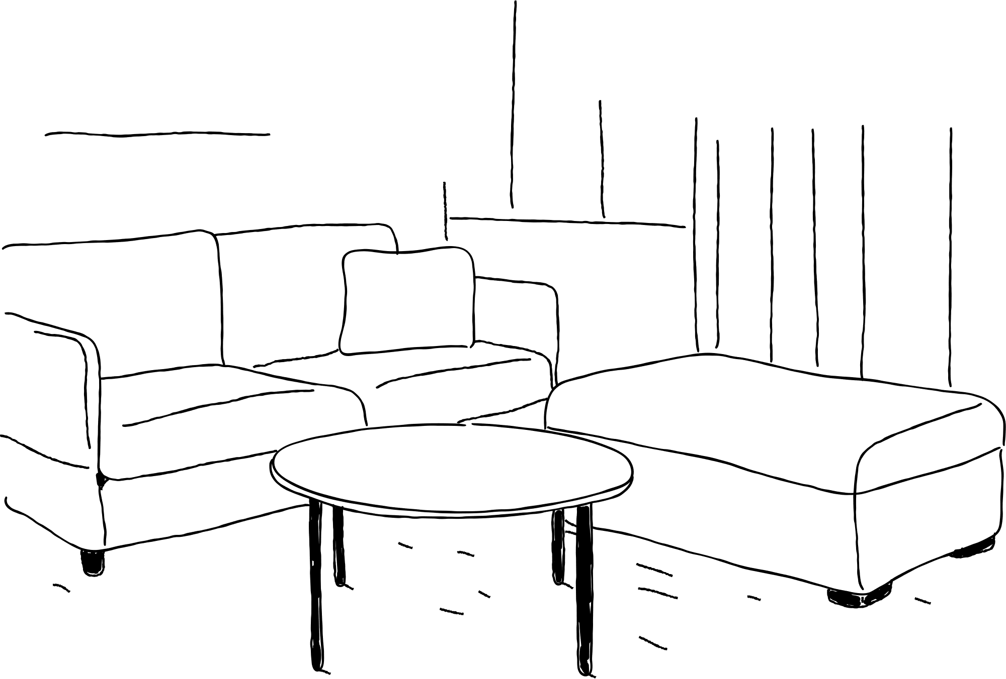
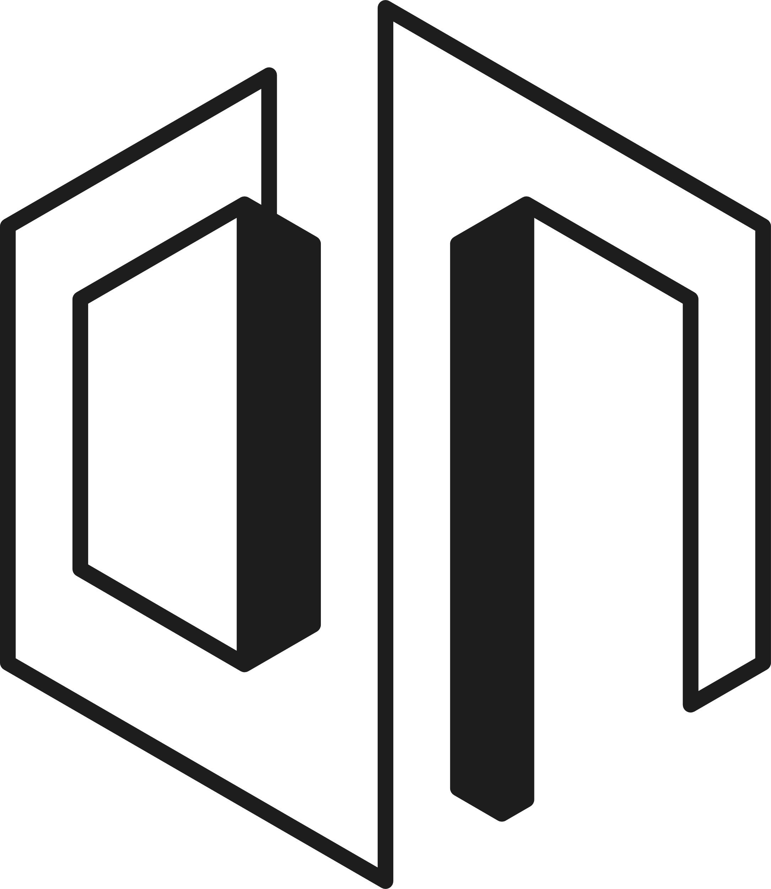

F. KOLODZIEJ
REAL ESTATE
Your Real Estate Consultant

Slide 2
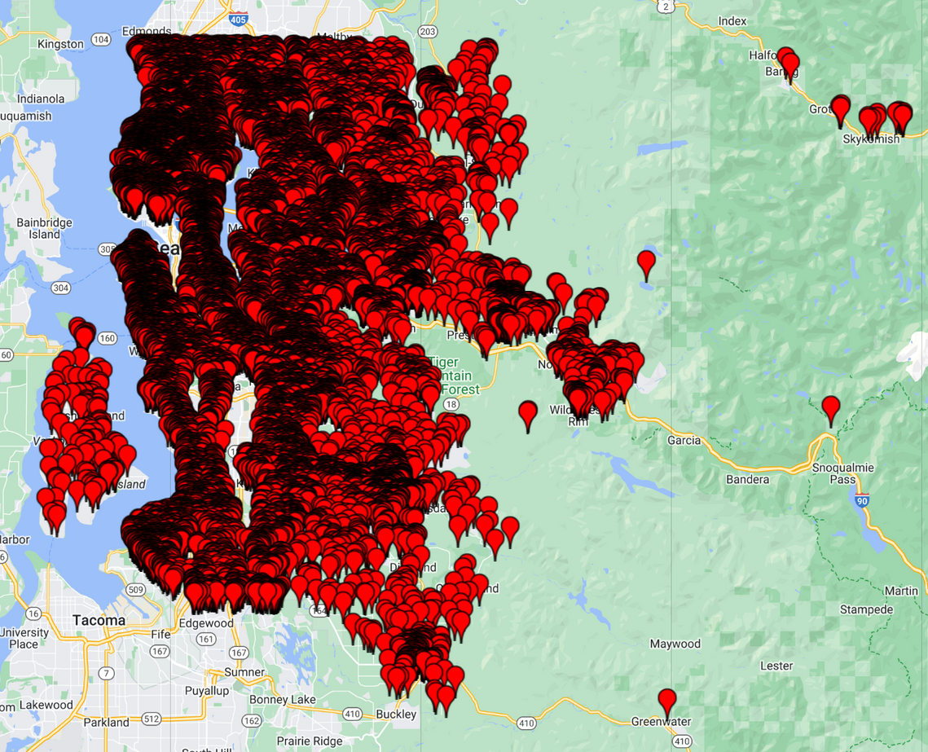
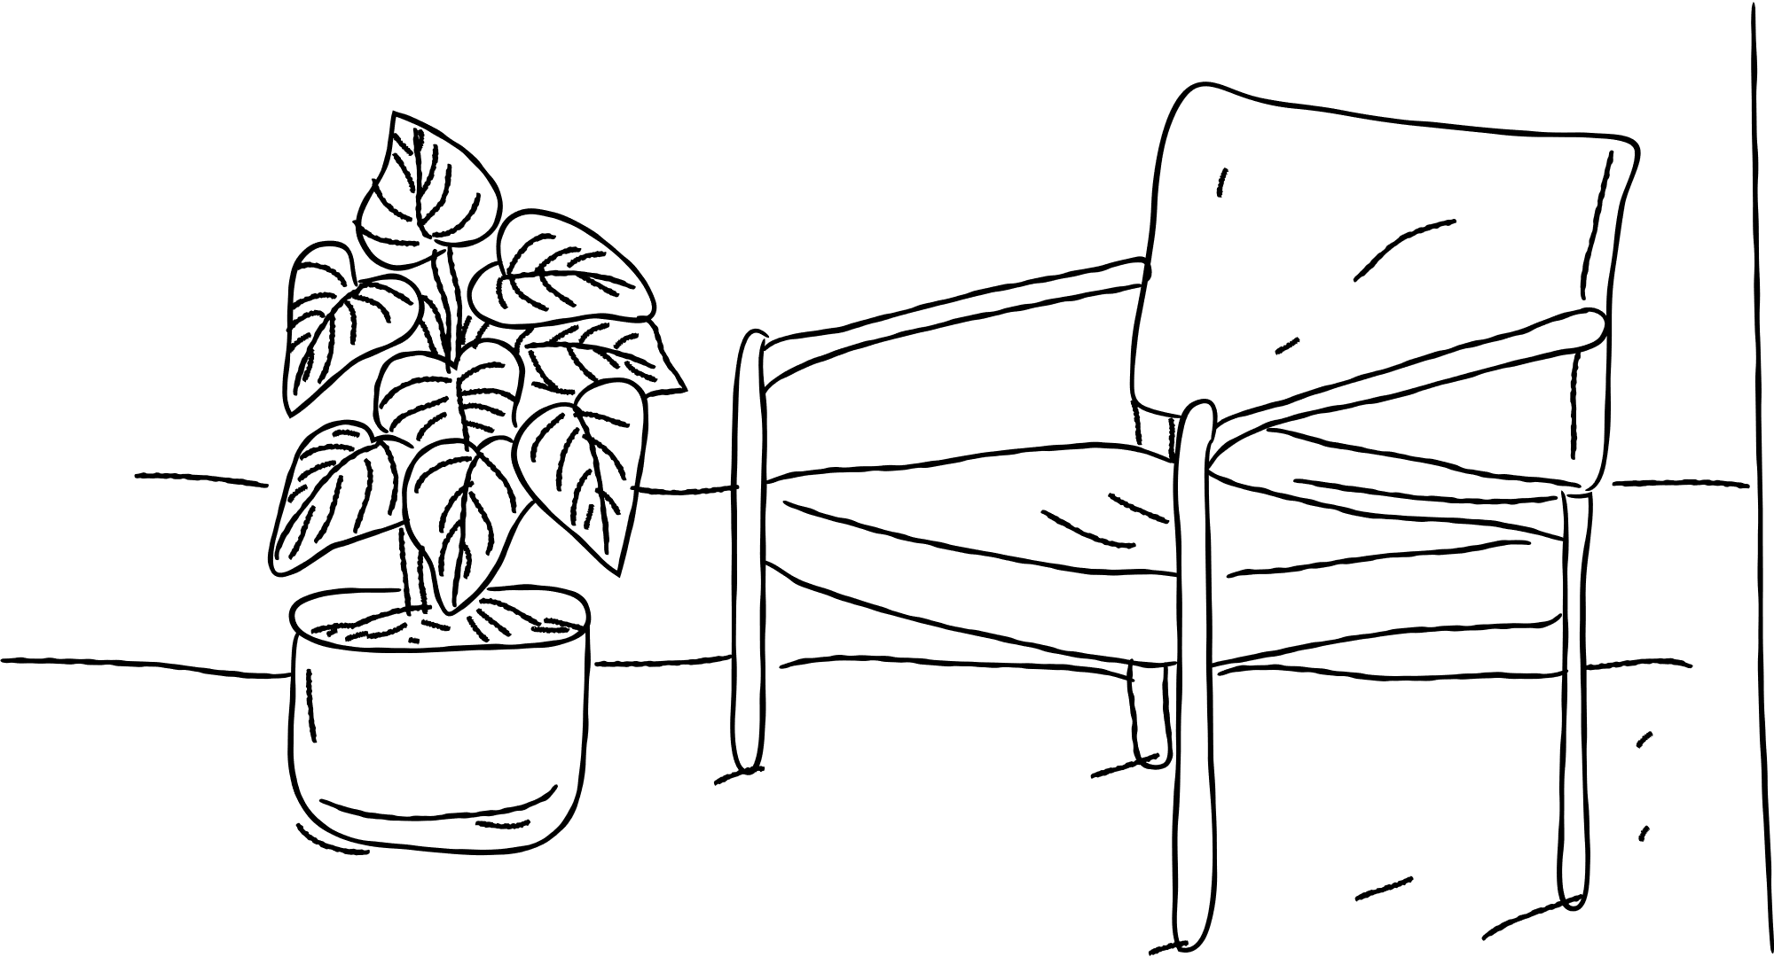
Your Commission:
You have tasked me with:
finding the ideal location,
estimating the cost, and
determining the timing
for your real estate purchase in the King County Area.
Map

Slide 3

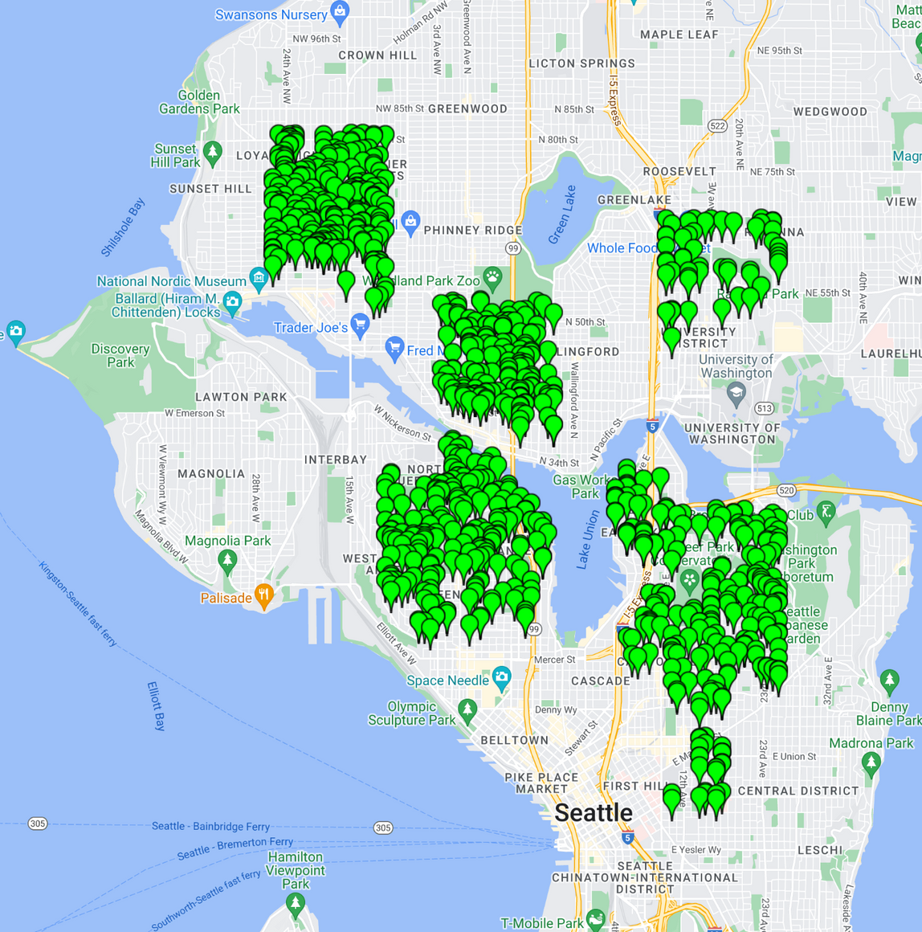
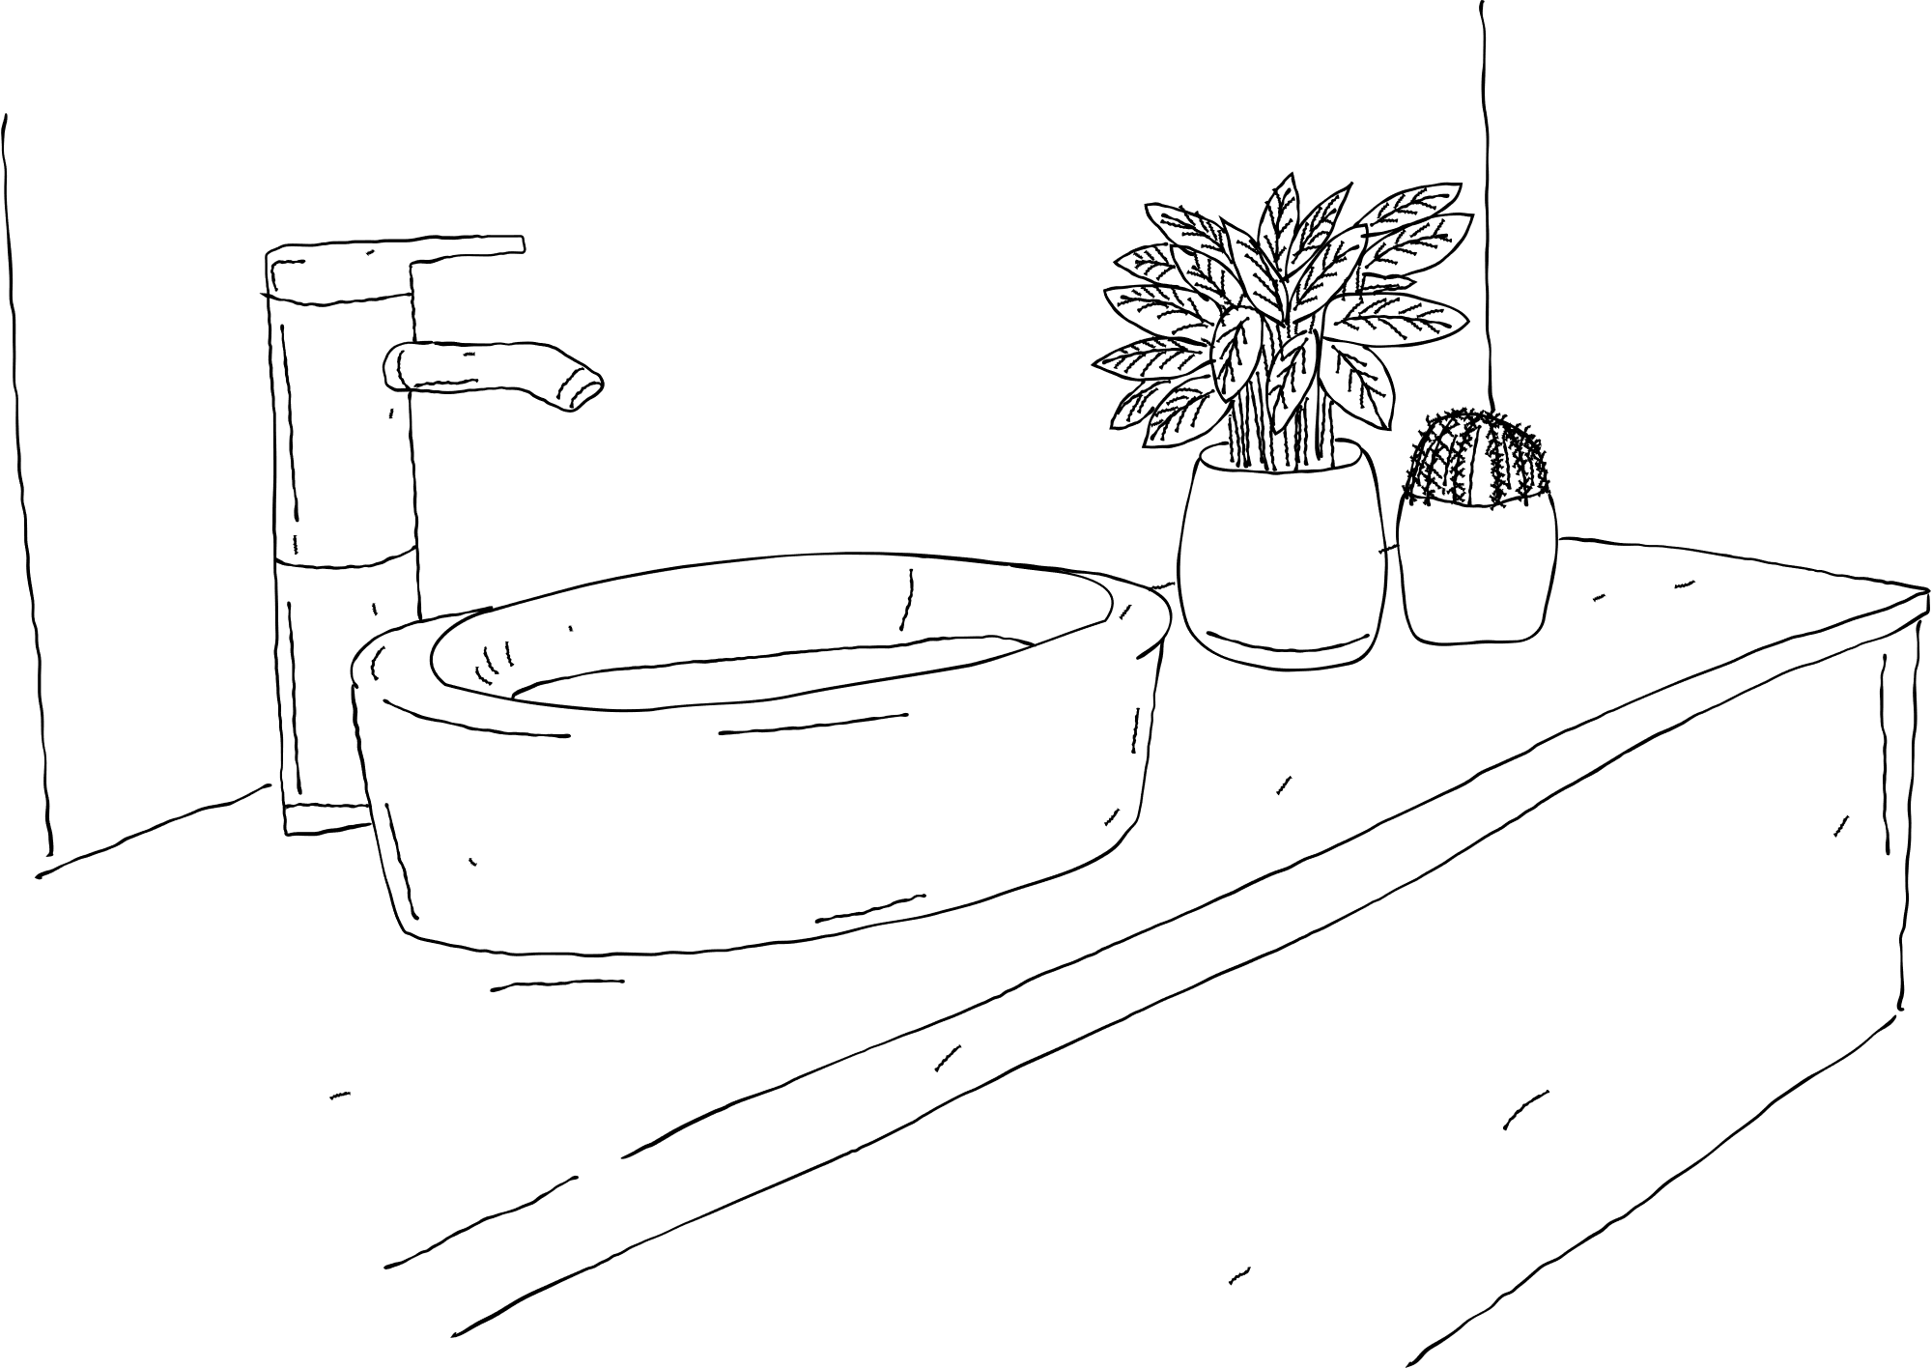
Right Location
University District:
Home to University of Washington campus with diverse dining and cultural venues.
Capitol Hill:
Vibrant nightlife, diverse residents, cultural events, and community gatherings.
Ballard:
Historic Scandinavian heritage, trendy food scene, and active community engagement.
Fremont:
Quirky atmosphere, artistic hub, public art, and lively cafes and boutiques.
First Hill:
"Pill Hill" with hospitals, mix of historic and modern buildings, and cultural institutions.
South Lake Union:
Tech hub with modern architecture, waterfront parks, dining, and retail options.
Queen Anne:
Iconic hilltop neighborhood with panoramic views, historic homes, upscale dining, and family-friendly amenities.
Map
Notes:
Insight: According to the Coordinates, these Real Estates where Sold in lively Neighborhoods
Recommendation: Chose one from these neighborhoods

Slide 4
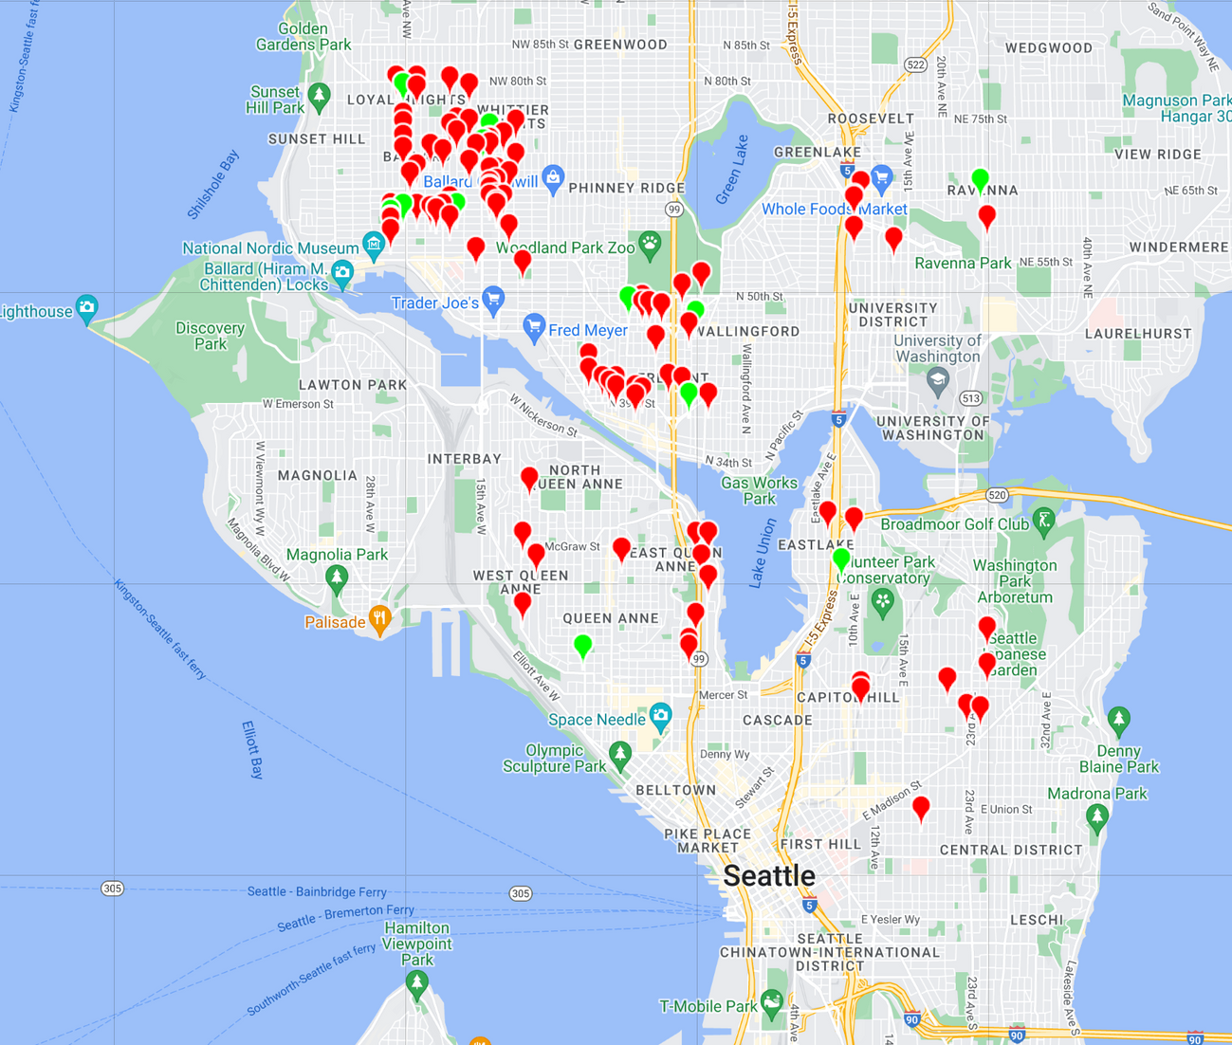

The right price
Map
Notes:
Insight: Middle Pricerange, according to the Median value of 450.000 from past sells is $425.000 - $475.000
Recommendation: You should buy a House that costs between $425.000 and $475.000

Slide 5

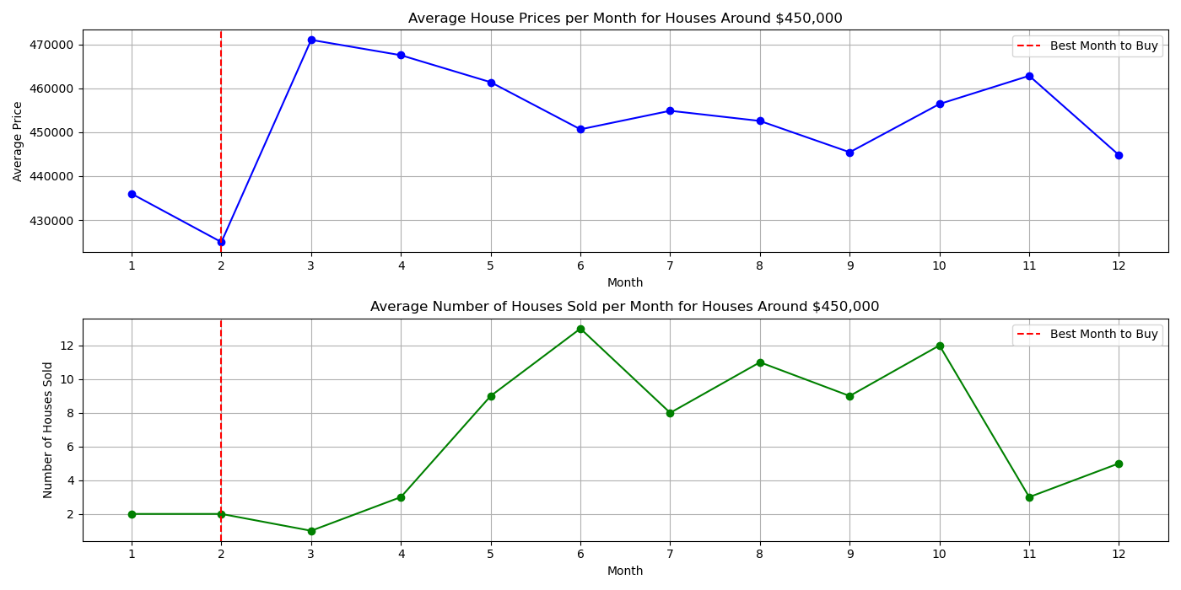
The right Time
Notes:
Insight: According to the last 2 Years of Data, the best Months to buy is between December and Febuary.
Recommendation: Buy in Dec to Feb, but be smart about it, there won‘t be many houses available to buy

Slide 6
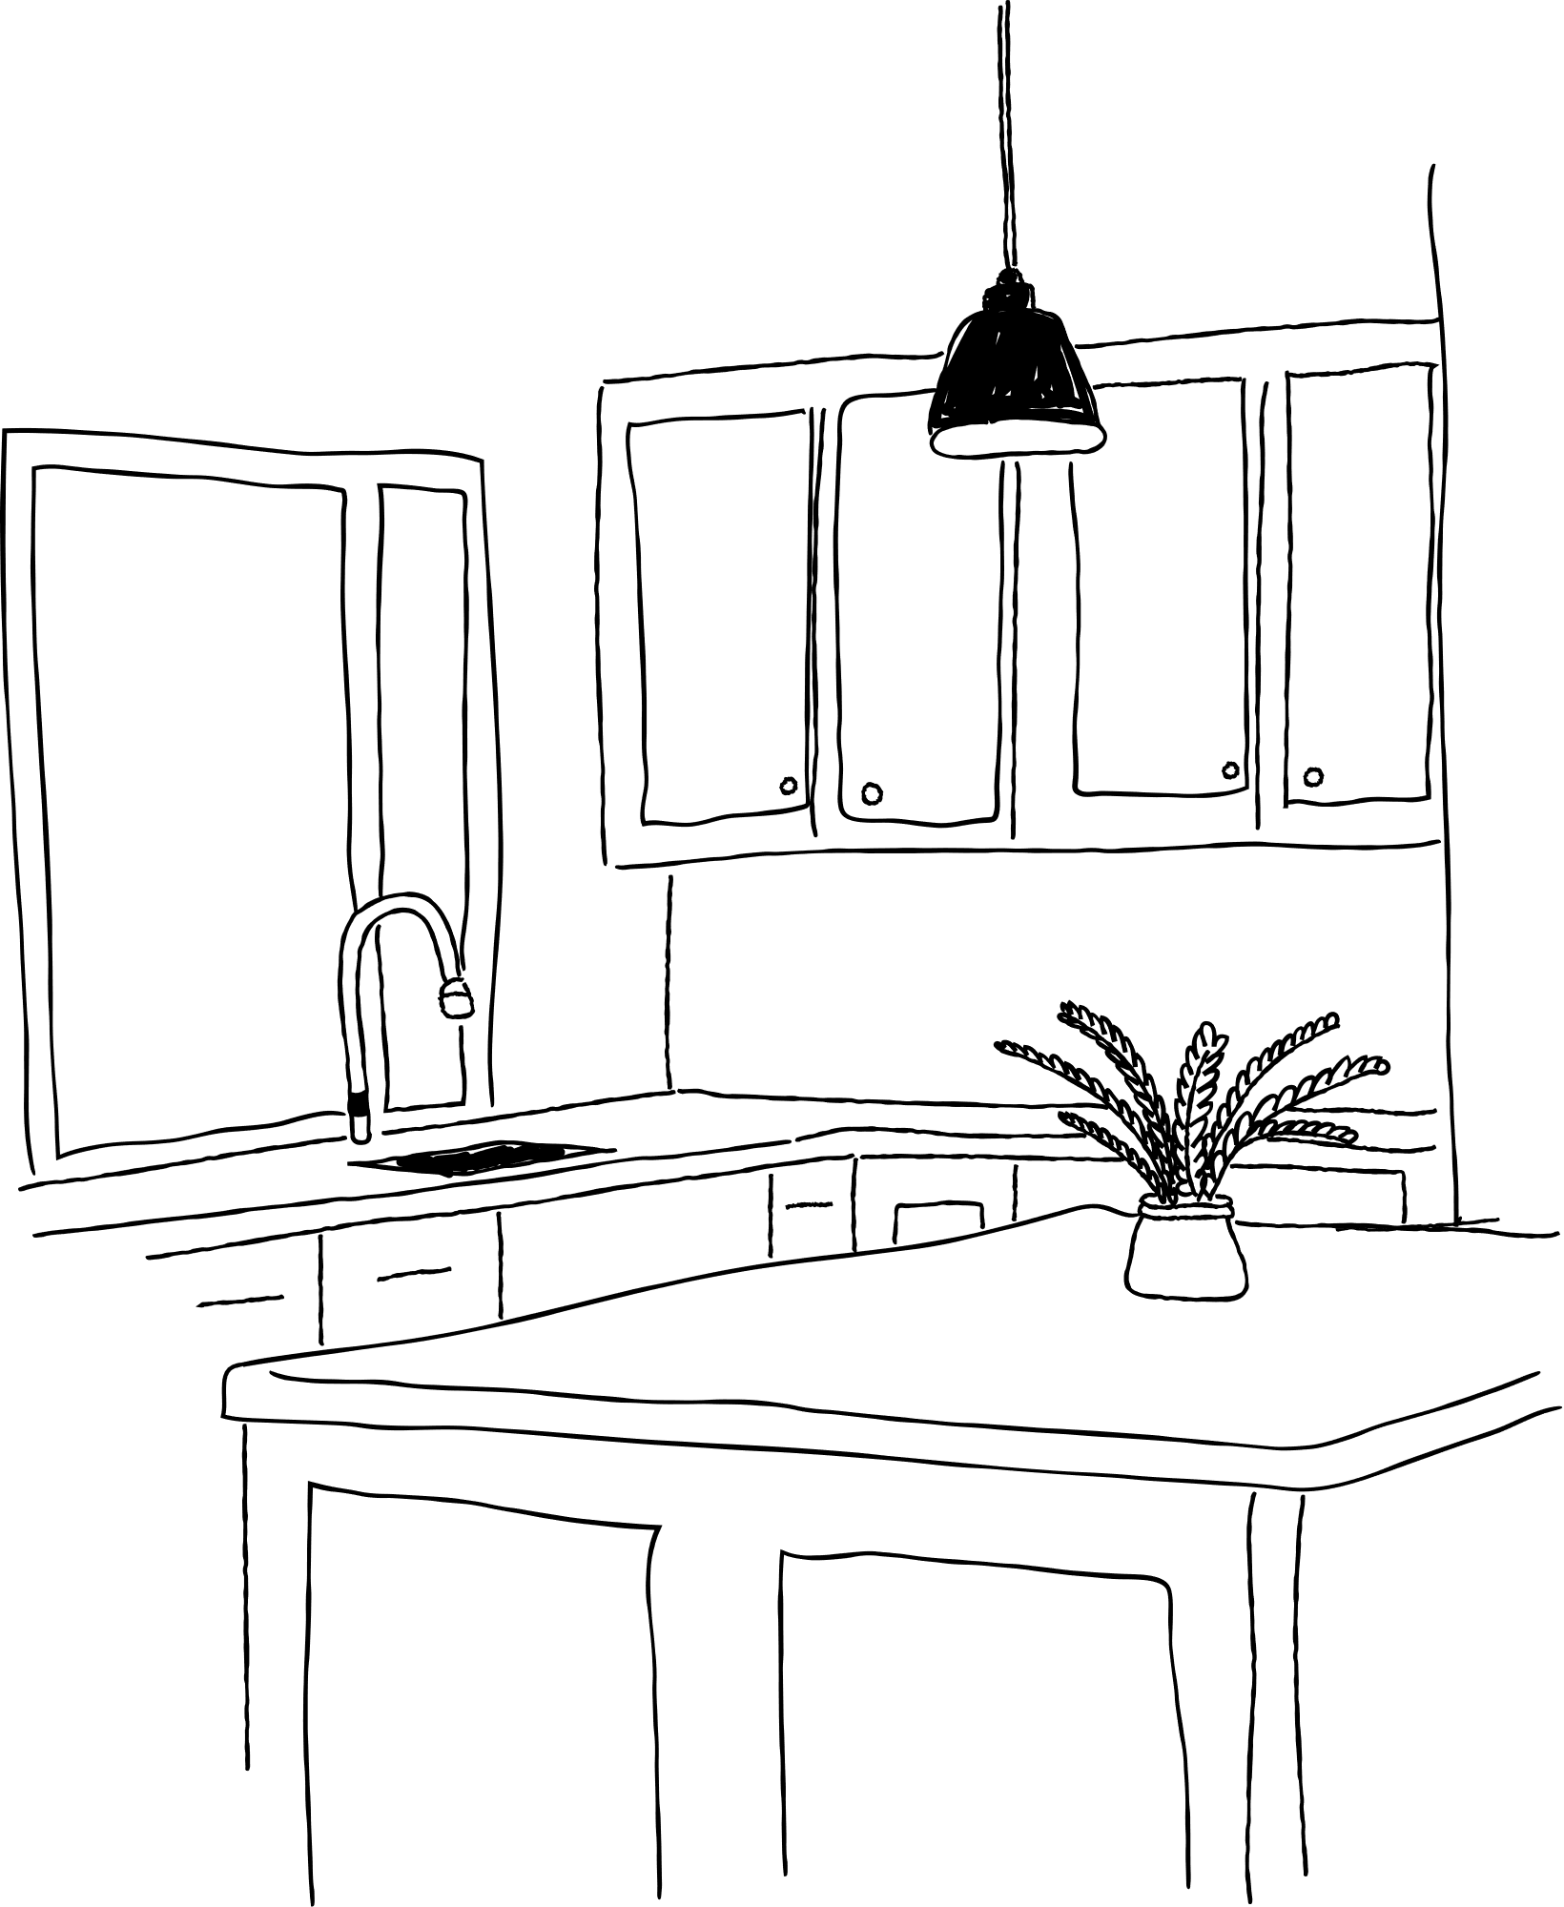
Summary:
The right Location
University District
Capitol Hill
Ballard
Fremont
First Hill
South Lake Union
Queen Anne
The right Price
Range of $425.000 - $475.000
The right Time
Between December and February

Slide 7


F. KOLODZIEJ
Thank you for your Tust!
IMMOBILIEN
F. Kolodziej
Imprint

